Slide 1

Unit 16 – Procedural Programming
with Ben Read

Slide 2
AIMS & OBJECTIVES
Review examples of good programming practice
Utilise what you’ve learned to improve your own code
Continue work on Assignment 2

Slide 3
COMMENTS & DOCUMENTATION
Commenting your code is essential, both to remind you of what your code does and, primarily, for others to be able to understand it easily –
//Call by Value - This function has its arguments passed but it does not return
//a value and the original values of the variables remain unchanged
printf("Before swap the value of a is %d\n", a);
printf("Before swap the value of b is %d\n", b);
swap(a, b); //Calls the swap function
printf("After swap the value of a is %d\n", a);
printf("After swap the value of b is %d\n", b);
//Call by Reference. This function uses pointers to access the actual
//parameter used in the call. This allows the function to change variables
//outside of its scope.
printf("Before swap the value of a is %d\n", a);
printf("Before swap the value of b is %d\n", b);
swapbyref(&a, &b); //&variable indicates the actual memory
//address of the variable
printf("After swap the value of a is %d\n", a);
printf("After swap the value of b is %d\n", b);

Slide 4
CONSISTENT INDENTATION
Indenting your code is pretty vital to its readability. If you don’t indent then it becomes very difficult to ascertain which scope is which, even when you have an IDE to help you. As well as this you need to be consistent. There are many styles of indentation which you can use. We all have a preferred style but it’s important that you pick one and stick to it, at least for the duration of your program.
There is no ‘best’ style but if you are part of a team then you need to decide on one that you will all use for a given project.

Slide 5
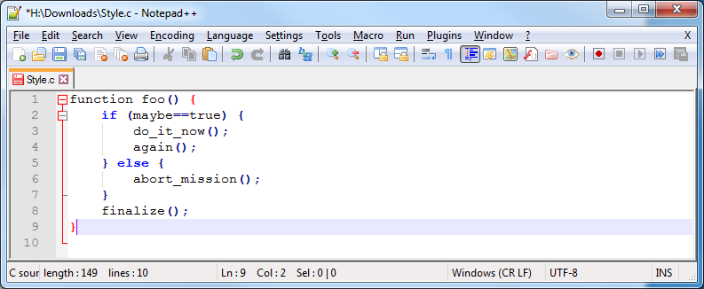
CONSISTENT INDENTATION – STYLE #1

Slide 6
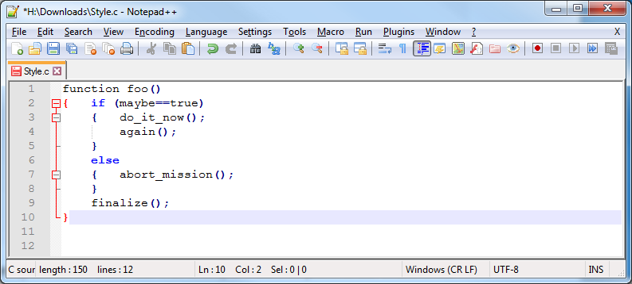
CONSISTENT INDENTATION – STYLE #2

Slide 7
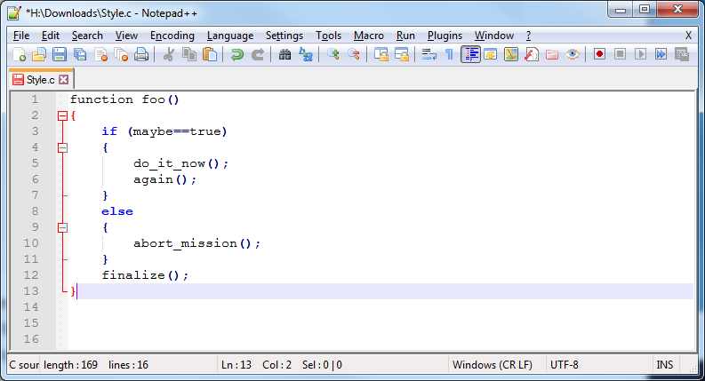
CONSISTENT INDENTATION – STYLE #3

Slide 8
AVOID OBVIOUS COMMENTS
Commenting your code is fantastic, however, it can be overdone or just be plain redundant. Take this example:
//Function which swaps the value of passed arguments but does not return
//the new values before they are destroyed
void swap(int x, int y)
{
//Creates the variable temp of datatype int
int temp;
//Passes the value of x to temp
temp = x;
//Passes the value of y to x
x = y;
//Passes the value of temp to y
y = temp;
return;
}
When the text is that obvious, it’s really not productive to repeat it within comments. It’s often best to summarise rather than comment on each and every line.

Slide 9
CODE GROUPING
More often than not, certain tasks require a few lines of code. It is a good idea to keep these tasks within separate blocks of code, with some spaces between them.
int *getRandom()
{
//An array within a function must be declared as static otherwise the
//memory it occupies will be cleared when the function terminates
static int r[10];
int i;
//Seeds the rand function with random numbers
srand(time(NULL));
//Populates the array and then prints each random number to the console
for (i = 0;i < 10;i++)
{
r[i] = rand();
printf("r[%d] = %d\n", i, r[i]);
}
return r;
}
Adding a comment at the beginning of each block of code also emphasizes the visual separation.

Slide 10
CONSISTENT NAMING SCHEME
Naming conventions for variables and functions are fairly common, and they help to easily differentiate them from the rest of the code. Two popular options are –
camelCase: The first letter of each word is capitalised, except for the first word.
PascalCase: All of the first letters of words are capitalised. Also known as UpperCamelCase
Underscores: Underscores are added between each word, e.g. player_health, enemy_health, ammo_count, etc.

Slide 11
CONSISTENT NAMING SCHEME
Having different options creates a situation similar to the indent styles, as I mentioned earlier. If an existing project follows a certain convention, you should go with that.
Also, some language platforms tend to use a certain naming scheme. For instance, in Java, most code uses camelCase names, while in PHP, the majority use underscores.
These can also be mixed. Some developers prefer to use underscores for procedural functions, and class names, but use camelCase for class method names.
There is no ‘best’ style. Just be consistent.

Slide 12
THE DRY PRINCIPLE
DRY stands for Don't Repeat Yourself. Also known as DIE: Duplication is Evil.
The principle states:
"Every piece of knowledge must have a single, unambiguous, authoritative representation within a system."
The purpose for most applications (or computers in general) is to automate repetitive tasks. This principle should be maintained in all code, even web applications. The same piece of code should not be repeated over and over again.
This is a great example of why we create functions with a mind to reusing them.

Slide 13
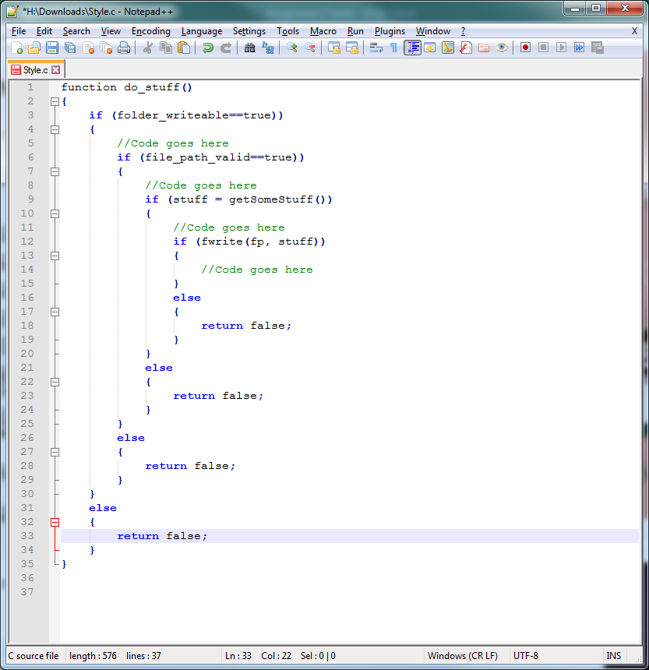
AVOID DEEP NESTING
Too many levels of nesting can make code quite hard to read. Wherever possible you need to avoid situations like this –
It’s usually possible to make changes to your code to reduce the level of nesting, e.g. use a different type of conditional statement

Slide 14

LIMIT LINE LENGTH
Our eyes are more comfortable when reading tall and narrow columns of text. This is precisely the reason why newspaper articles look like this:

Slide 15
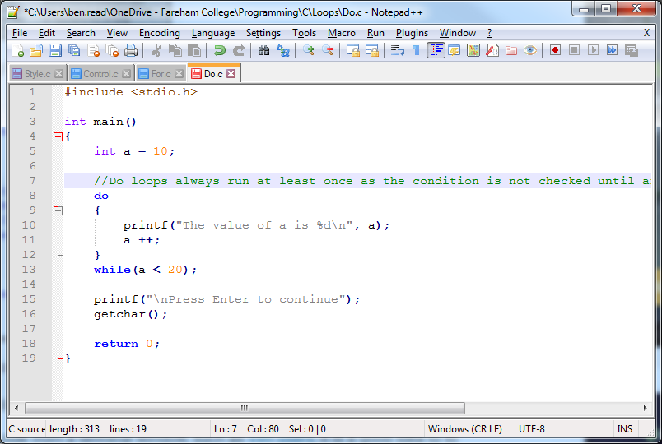
LIMIT LINE LENGTH
Therefore it’s good practice to avoid writing horizontally long lines of code. Remember, if anyone intends to read your code via a terminal window, such as the Vim text editor for UNIX, it’s a good idea to limit the line length to around 80 characters.
Don’t comment like this
Note the column number

Slide 16
READ OPEN SOURCE CODE
Open Source projects are built with the input of many developers. These projects need to maintain a high level of code readability so that the team can work together as efficiently as possible. Therefore, it is a good idea to browse through the source code of these projects to observe what these developers are doing. C tutorial sites host great examples of code which have been written with good programming practice in mind –
https://www.programiz.com/c-programming/examples
https://www.tutorialspoint.com/cprogramming/index.htm
https://www.developerinsider.in/c-and-cpp-insider/

